Slide 1
Complex Medical Claims
OHFT CMCoE Team
March 2025

Slide 2
Complex Medical Claims – On-Prem Assessment
Provider Express is a provider/physician portal for United Behavioral Health for data access and is part of LAWW App Suite.
Timelines: Start: Apr 2024 | End: Jan 2025
Migration Observations and Gaps
Recommendations
Risk
Type | Observation
App Architecture | Modernizing Application Architecture with cloud native adoption framework, would bring in 30-50% reduction in TCO and optimized performance.
Data Management | There is a dependency between LAWW, PE and BH Shared Gateway, all are being migrated together Future state infrastructure is not clearly defined with some pending decisions around database
Security & Compliance | Exception created for BH Shared Gateway to connect to on-premises database. HIPPA and PII data are stored in the DB. Migrated architecture is leveraging UCP v1 which make require an upgrade soon
Business Continuity | DR plan is missing
Cloud Readiness | Target infrastructure architecture missing source and destination ports and target infrastructure.
Migration Process | Migration plan is missing details around testing and rollback Disaster Recovery Plan not included with migration plan
Review process for updating and maintaining data bases and Kubernetes clusters to ensure reliability
Conduct review of cost optimizations after 6 months of operations
To ensure maintainability, evaluate GCP interconnect v1, once service mesh is in place, reevaluate connectivity
Consider adopting IAC Automation for improved efficiency & scalability. Likewise, IBM Global Security can be replaced with cloud native components like Secret Manager, Encryption, etc.
Consider GCP native tools for SFTP, Managed Message Queues for enhanced observability and accelerated engineering efforts.
Consider GCP BC/DR Planning.
GCP connectivity for BH Shared Gateway JDBC connection needs to be tested for stability and functionality
Tech Stack
Apache Tomcat, Bison, ATA SMART, IBM Global Security Kit, IBM Workload Scheduler, Percona MySQL, Python, Rabbit MQ, RH LVM, Ruby, Smartmontools, Vintela Authentication Services, Vsftpd FTP Server, jconnect.
RASP Recommendations
Reliability – High Availability and Plan for BC/DR​
Availability – Recommended 99.95% or up​
Scalability – Elastic and size up based on cloud demands. ​
Performance – Secure performance benchmark numbers from private cloud to plan public cloud sizing
Overall | Data Management | Security & Compliance | Business Continuity | Cloud Readiness | Cost Management | App Architecture
Notes:
Details on Scoring
Overall: Dependent on solution for GCP connectivity to on prem for BH Shared Gateway
Data Management: Replatforming to GCP Cloud SQL, required connectivity to on prem
Security & Compliance
Business Continuity: Missing DR plan
Cloud Readiness: Use of UCP v1 may require an upgrade soon.
Cost Management: N/A
Migration Process: Migration plan exists, but with some gaps

Slide 3
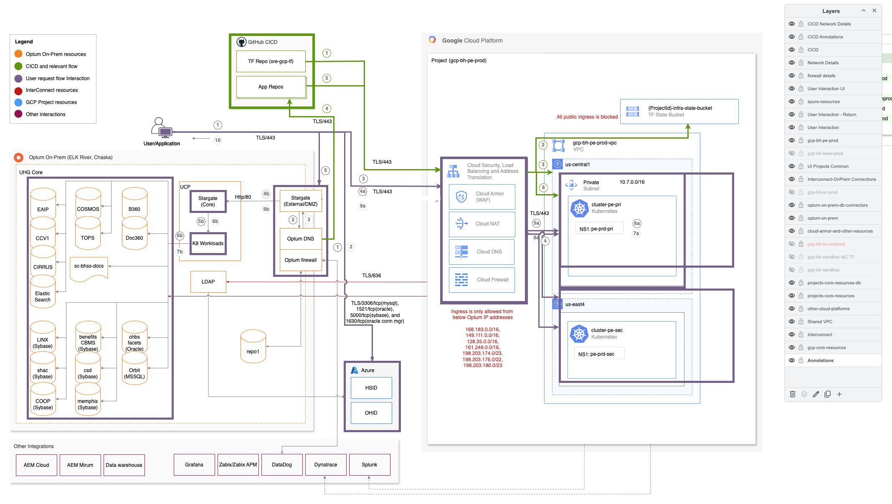
Complex Medical Claims – Target State & Follow Up Recommendations
Performance Optimization Opportunities - Review operational results of migration to characterize improvements and identify further opportunities for optimization. Leverage GCP native tools for observability like Cloud Logging, Cloud Monitoring, Managed Prometheus, Cloud Trace (Latency/Response Time Management), Cloud Profiler etc.
Cost Optimization - Consider leveraging Cloud Profiler for cost optimization opportunities. Ensure the infrastructure is not over provisioned.
Decommissioning - Some HCC On-Prem K8S instances (Jenkins) and On-Prem Prod Servers are still up and running. At this point, only the non-prod and staging servers are down. The On-Prem servers need to fully reviewed and decommissioned.
BC/DR - Leverage cloud platform capabilities to setup effective high availability, business continuity and disaster recovery as per the desired RPO (1 Hour) & RTO (8 Hours) objectives. The last DR exercise was done on 2024 as per records. Please ensure the new production infrastructure hosted in GCP has the necessary BC/DR and is satisfying the RPO/RTO objective. Ensure data backups & recovery are managed with CSP tools and automation.
Role Based Access Control (RBAC) – Ensure there is proper RBAC leveraging IAM policies. .
Optum Portals - Update TechOps & OneView portal to reflect the latest architecture, observability data & TCO. At present this data is not properly reflected in the Optum Portals. App team should ensure and maintain BC/DR plan and records for their application. Ensure BC/DR plan and events are recorded.
Security & Compliance – Ensure doing a complete assessment and report on Cloud Security, so there are not accidental Denial Of Service Attacks, Public IPs, Any-Any open ports, etc.
IAC, Build Documents & Architecture Diagrams – Infrastructure build/deployment is manual. Also, Architecture Diagram is not current and up to date.
Overall | Data Management | Security & Compliance | Business Continuity | Cloud Readiness | Cost Management | App Architecture
Notes:
Details on Scoring
Overall: Dependent on solution for GCP connectivity to on prem for BH Shared Gateway
Data Management: Replatforming to GCP Cloud SQL, required connectivity to on prem
Security & Compliance
Business Continuity: Missing DR plan
Cloud Readiness: Use of UCP v1 may require an upgrade soon.
Cost Management: N/A
Migration Process: Migration plan exists, but with some gaps

